Slide 1
Finefood multi-restaurant

Slide 2
introduction
FineFood is a web application that helps people choosing and ordering food from nearby restaurants
The user selects a restaurant of his or her choice and browse through the menu before proceeding to the order. This will help people discover new restaurants, have a larger choice of menus, and save time by ordering online.
The application should also give restaurant managers a platform for processing incoming orders, as well as, a way of communicating with their customers.

Slide 3
Goals and objectives
Gather food from different restaurants and display to the user for consumption
Improve owners standard of living
Increasing restaurants sales.
Quick and easy access to restaurant food
Digitalizing food aspects as there are accesed online

Slide 4
User’s functionalities
-A user should be able to sign up using his/her email address
-A user should be able to sign in using his/her email address
-A user should be able to search for restaurants by category, city, and name (upcoming!)
-A user should be able to sort restaurants by nearest, most popular, and top rated (upcoming!)
-A user should be able to filter results by delivery type, category, and neighborhood (upcoming!)

Slide 5
-A user should be able to get more information about a specific restaurant such as description, opening hours, address, and pictures
-A user should be able to grade and post a review about a restaurant (upcoming!)
-A user should be able to view the average grade of a restaurant and reviews from other users (upcoming!)
-A user should be able to view the restaurant’s menu
-A user should be able to select items from the restaurant’s menu
-A logged user should be able to make an order with the selected items from the restaurant’s menu
-A user should be able to view his/her orders

Slide 6
Manager’s functionalities
-A manager should be able to sign up using his/her email
-A manager should be able to sign in using his/her email
-A manager should be able to add a menu to his/her restaurant
-A manager should be able to process the received orders
-A manager should be able to view his/her customers
-A manager should be able to change his/her restaurants information

Slide 7
Super Admin functionalities
- A super-admin should be able to approve/reject restaurant request
- A super-admin should be able to view all payments
- A super-admin should be able to view all users
- A super-admin should be able to view all orders

Slide 8
Achievements
Our project was achieved at the level of 70% as the are caused by some different reasons :
Unstable internet
Working with the framework at first time
Time was not favourable as we had t deal with other modules too we tried to balance time.

Slide 9
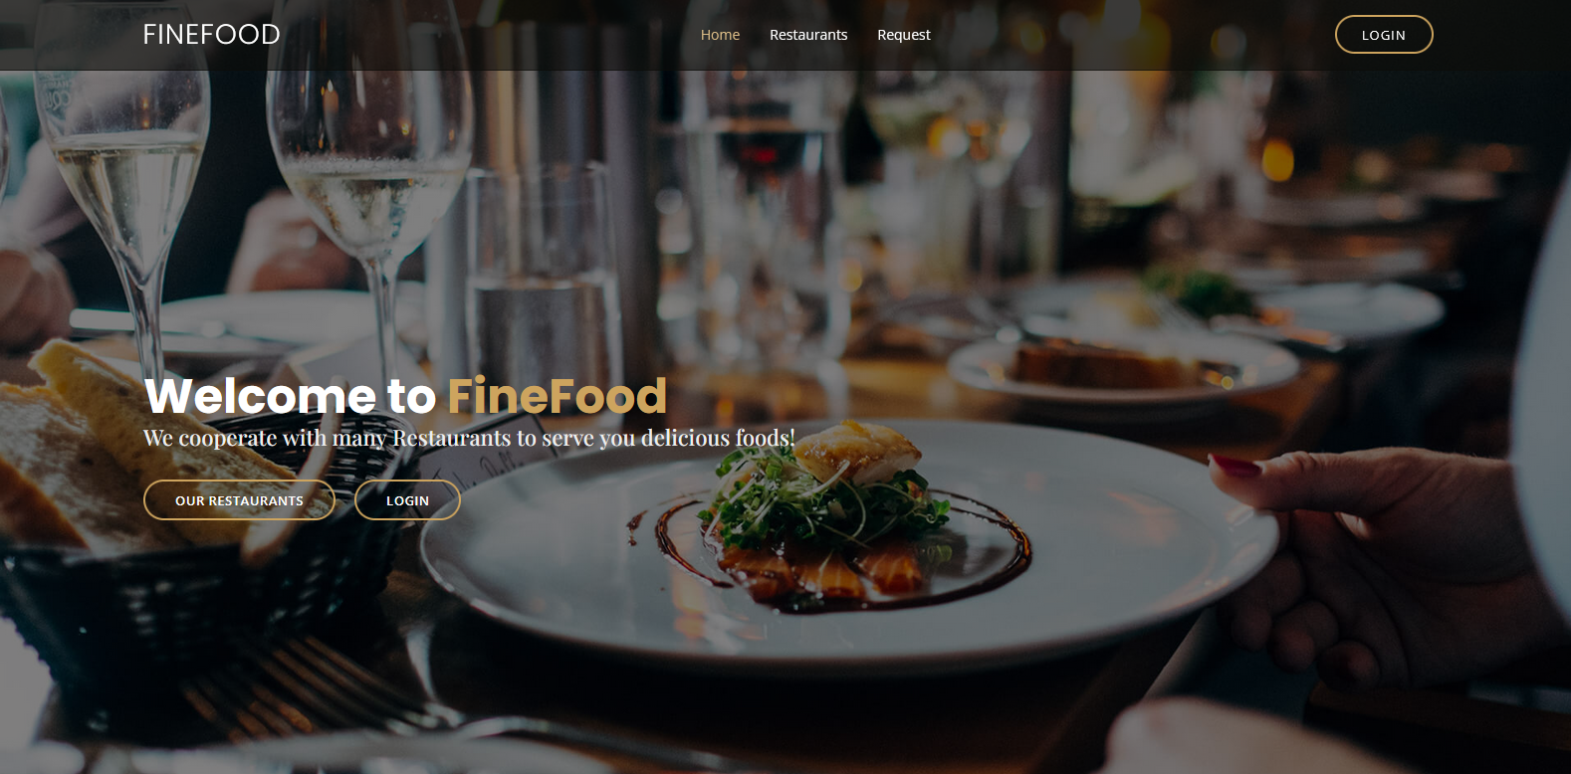
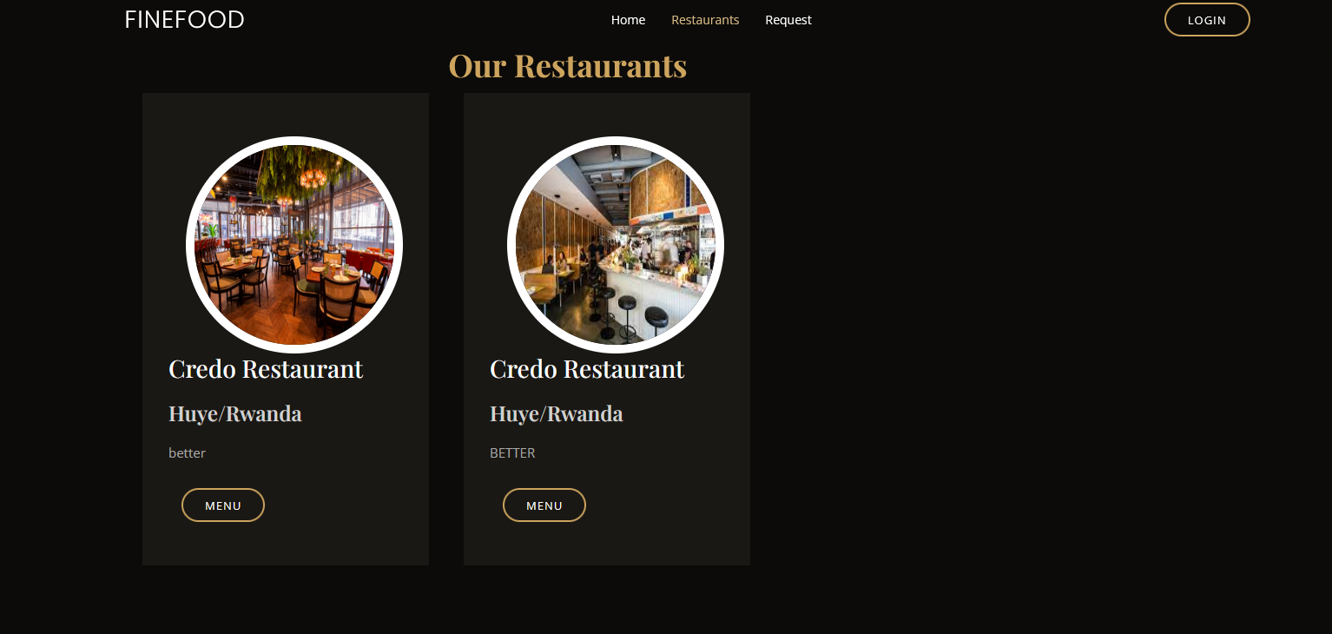
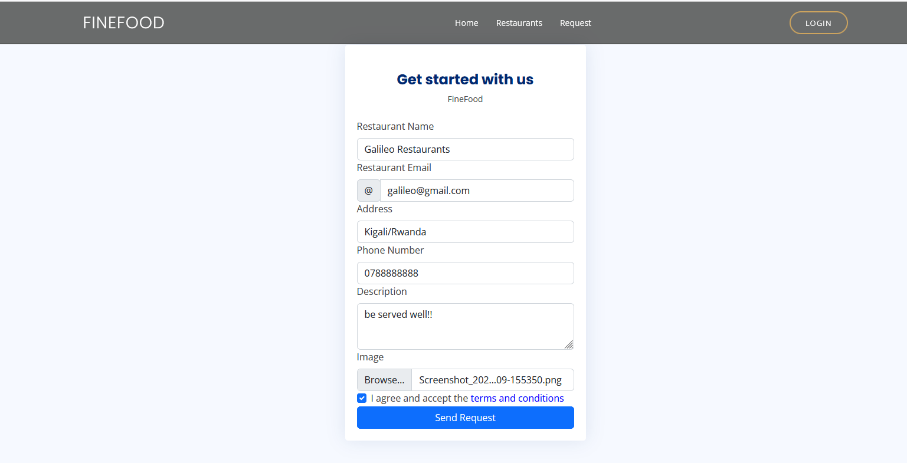
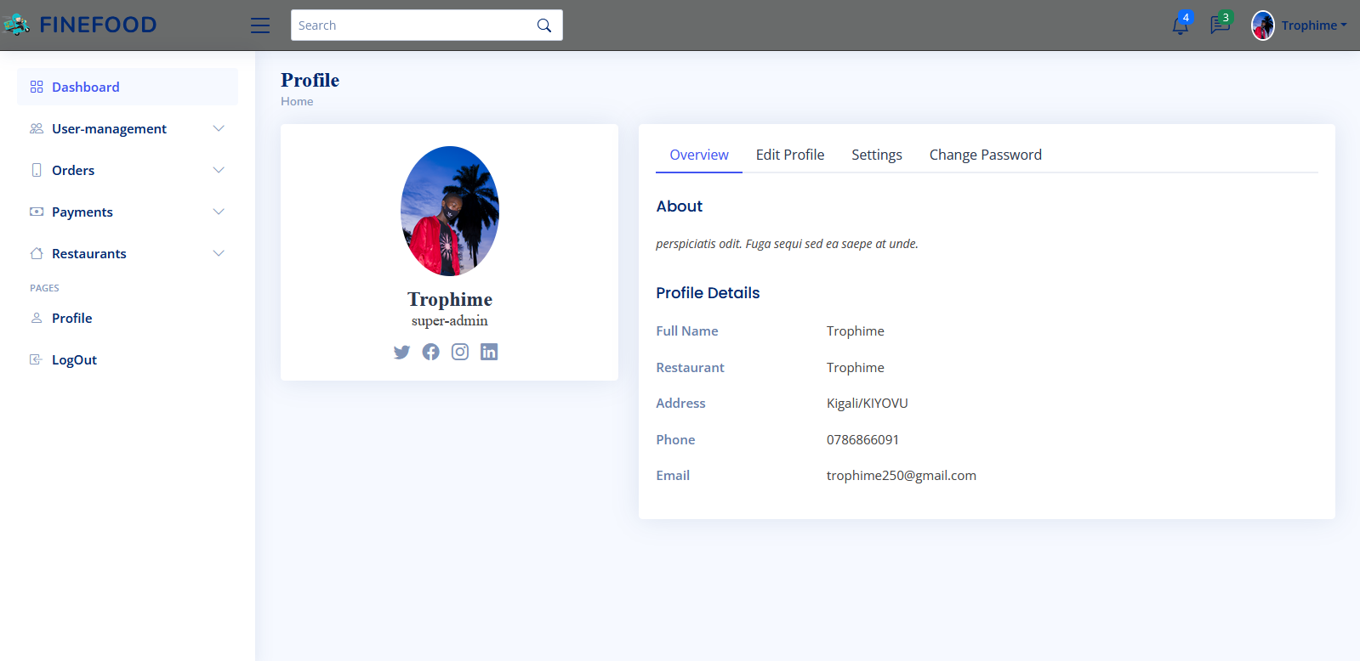
Project page review

Slide 10
Conclusion
FineFood was an interesting project to work on, I used many great tools to achieve this result. Working with Laravel and views with html&css bootstrap was very interesting, it requires a deep knowledge in programming, and a good understanding of internal features. Working on this project made me learn more about many of the recent technologies such as Laravel and MYSQL. There are many possibilities to improve this project for future work. For instance, we can add more features on the manager side that will help in better understanding customers, by displaying accounting and financial results. Also, one improvement would be to suggest new restaurants to a user depending on previous choice, by using machine learning algorithms. For now, the customer can pay only by cash when the order is delivered; however, it would be better if the user could pay by credit or debit card.

Slide 11
Team
Trophime KARASISI 220002679
Marie Rose MWISENEZA 220004010
Credits goes to:
University of Rwanda
Lecture: Mr Eric HITIMANA
KTU Developers

